Slide 1

Python Fundamentals
Course Introduction
SoftUni Team
Technical Trainers
Software University
https://softuni.bg/

Slide 2
Table of Contents
Course Objectives
Training and Team
Course Organization
Course Infrastructure
Evaluation Criteria
2

Slide 3
Have a Question?
sli.do
#fund-python

Slide 4












SoftUni Diamond Partners

Slide 5


Educational Partners

Slide 6

Course Objectives

Slide 7
Python Fundamentals Objectives
Working with linear data structures
Lists
Defining functions and simple classes
Working with objects
Processing and manipulating strings
Regular expressions
7

Slide 8
Practical Programming Exam
Mid Exam – 4 hours
3 practical problems
Conditional Statements and Loops
Linear Data Structures – Lists
Final Exam – 4 hours
3 practical problems
Dictionaries
Strings and Text Processing
Regular Expressions
8

Slide 9
Theoretical Exam
You will have 30 minutes once you enter
Multiple-choice with 1 correct answer
Test will be in English
Automated quiz system
Available online on the day of the practical exam
You can submit your answers just one time
9

Slide 10

The Team

Slide 11
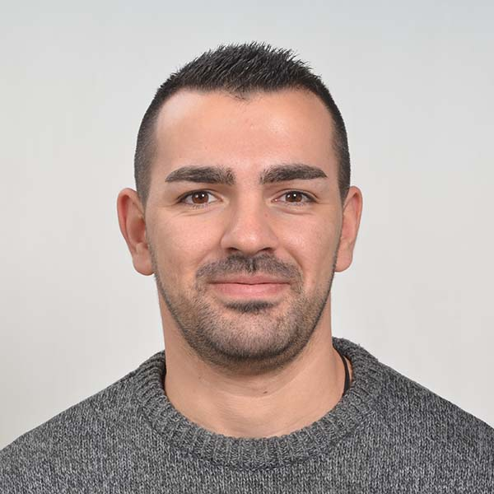
Mario Zahariev
Top student at SoftUni
Master of Cyber Security
3+ years of experience on Python
Interested in JavaScript, Artificial Intelligence and Go
Involved in researches related to artificial intelligence and machine learning

Slide 12
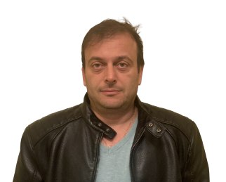
Ivan Shopov
DevOps & Software Developer at IBM
Top Student at SoftUni
Technical Trainer at SoftUni
Interested in coding with Python 3

Slide 13

Course Organization

Slide 14
Python Fundamentals Module
16-May-2022
26-Jun-2022
07-Aug-2022
11-Aug-2022
15-Aug-2022
Python Fundamentals
12 weeks * 3 times / week
12 credits
Start: 16-May-2022
Mid Exam: 26-Jun-2022
Final Exam: 07-Aug-2022
Theoretical Exam: 07-Aug-2022
Re-Take Exams
Mid Exam Retake: 11-Aug-2022
Final Exam Retake: 15-Aug-2022
Theoretical Exam: 15-Aug-2022

Slide 15
Course Scoring
Practice grade:
Theory grade:
SoftUni Certificate: 5.00 from Practice
CPE Certificate: 3.00 average from Practice + Theory
Practical Mid Exam
Practical Final Exam
Homework
40 %
60 %
+5 %
Theoretical Exam
100 %
15

Slide 16

Homework Assignments & Exercises
Your homework is mainly work in class
Lesson days → slides + live demos + exercises
Exercise days → only exercises
How to submit your homework?
Submitted in the judge system
Do your homework when it's due
Assignments pile up quickly

Slide 17



Course, Forum and FB Group
Official web site:
Official discussion forum:
Official Facebook group:
Python Community Facebook group:
https://softuni.bg/trainings/3733/programming-fundamentals-with-python-may-2022
https://softuni.bg/forum/categories/784/python-fundamentals
https://www.facebook.com/groups/ProgrammingFundamentalswithPythonMay2022
https://www.facebook.com/groups/SoftUniPythonCommunity

Slide 18
Questions?
Notes:
18

Slide 19
Trainings @ Software University (SoftUni)
Software University – High-Quality Education, Profession and Job for Software Developers
softuni.bg, about.softuni.bg
Software University Foundation
softuni.foundation
Software University @ Facebook
facebook.com/SoftwareUniversity
Software University Forums
forum.softuni.bg
Notes:
19

Slide 20

License
This course (slides, examples, demos, exercises, homework, documents, videos and other assets) is copyrighted content
Unauthorized copy, reproduction or use is illegal
© SoftUni – https://softuni.org
© Software University – https://softuni.bg
Notes:
20

